Slide 1

cron
Linux Task Scheduler

Slide 2
cron
Allows you to schedule repetitive tasks.
Schedule is stored in the ‘crontab’ (time table) located in /etc.
You can schedule any executable command.
Can be used by any user.
Permissions still apply, so if you need to sudo a command to get it to work it should be scheduled by root.

Slide 3
cron directories
ls -ld /etc/cron*
drwxr-xr-x 2 root root 4096 Jan 8 09:58 /etc/cron.d drwxr-xr-x 2 root root 4096 Mar 20 06:13 /etc/cron.daily drwxr-xr-x 2 root root 4096 Jan 8 09:56 /etc/cron.hourly drwxr-xr-x 2 root root 4096 Jan 8 09:56 /etc/cron.monthly -rw-r--r-- 1 root root 722 Apr 5 2016 /etc/crontab drwxr-xr-x 2 root root 4096 Feb 5 20:51 /etc/cron.weekly

Slide 4
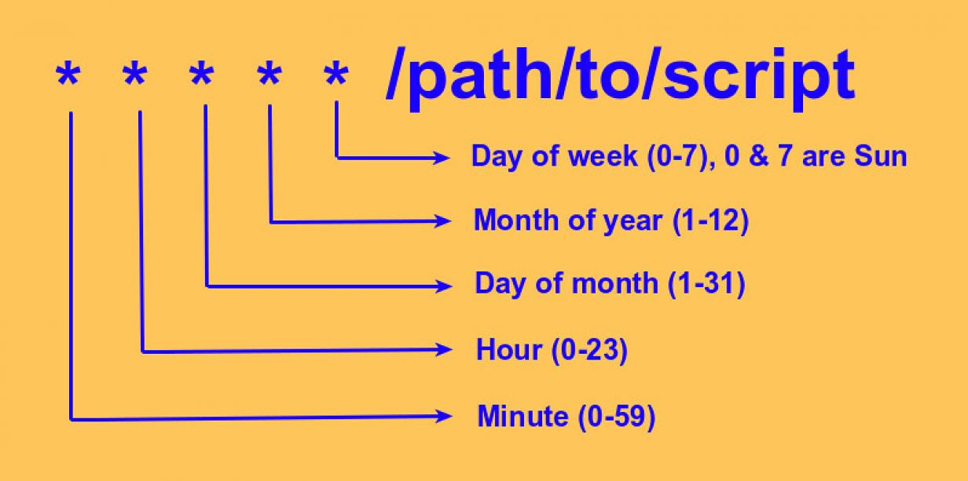
cron (task scheduler)

Slide 5
Crontab syntax
Entry | Description | Equivalent to
@yearly | Run once a year at midnight January 1. | 0 0 1 1 *
@monthly | Run once a month at midnight on the first day of the month. | 0 0 1 * *
@weekly | Run at midnight on Sunday morning. | 0 0 * * 0
@daily | Run once a day at midnight. | 0 0 * * *
@hourly | Run once an hour on the hour | 0 * * * *
@reboot | Run at startup

Slide 6
Listing crontab entries
sudo crontab –l
no crontab for root

Slide 7
Nano Handy Keys
CTRL-O – Write the file
CTRL-X – Exit
CTRL-W – Whereis (search for a text string)
CTRL-K – Delete line
CTRL-U – Undelete
CTRL-G – Get Help

Slide 8
Adding a new crontab entry
sudo EDITOR=nano crontab –e
min | hour | mday | month | wday | command
00 16 * * * echo ‘cron runs’ > /var/log/syslog
Means:
At exactly 16:00 of any day of the month, of any month, on any weekday, execute the echo command.
The cron job becomes active as soon as the file is saved.
If the file won’t save, you likely made a syntax error somewhere

Slide 9
Adding a new crontab entry
sudo EDITOR=nano crontab –e
min | hour | mday | month | wday | command
5,15 2-6 1,15 8-10 * systemctl restart xinetd
Means:
At 5 minutes and 15 minutes after 2:00 – 6:00, on the 1st and 15th day of the month, of the months Aug - Oct, on any weekday, restart xinetd.
3:05 on August 15th?
6:15 on May 10th?
4:45 on September 1st?

Slide 10
Adding a new crontab entry
sudo EDITOR=nano crontab –e
min | hour | mday | month | wday | command
00 00 * * 7 ping 8.8.8.8 –c 5 > /tmp/google.ping.stat
Means:
At midnight on Sunday, ping Google DNS 5 times and store the output in /tmp/google.ping.stat.

Slide 11
Adding a new crontab entry
sudo EDITOR=nano crontab –e
min | hour | mday | month | wday | command
*/2 * * * * nslookup google.com > /tmp/google.dns
Means:
Every 2 minutes, lookup google.com and redirect the output to /tmp/google.dns.

Slide 12
cron Summary
To edit the crontab with nano, use the following line:
sudo EDITOR=nano crontab –e
To list your cron jobs:
sudo crontab -l
To check to see if your cron jobs ran:
grep “CRON” /var/log/syslog

